Slide 1
Unit 4

Slide 2
Basic Computer Organization and Design
Instruction and Instruction Code
Computer Instructions
Timing and Control
Instruction Cycle
Memory Reference Instructions
Input/Output and Interrupts
Complete Computer Description
Machine Language
Assembly Language
The Assembler

Slide 3
Program Loops
Programming Arithmetic & Logic
Subroutines
Inputs/Outputs Programming
Microprogrammed Control
Control Memory
Address Sequencing
Microprogram Example
Design Control Unit

Slide 4
SESSION:9&10
Instruction and Instruction Code
Computer Instructions
Timing and Control
Instruction Cycle
Memory Reference Instructions
Input/Output and Interrupts
Complete Computer Description

Slide 5
Instruction and Instruction Code
The collection of bits that instruct the computer to perform a specific operation is called an instruction code. Operation part is the most basic part of an instruction code. The operation code of an instruction is a group of bits that define such operations as add, subtract, multiply, shift and complement. The total number of operations available in the computer determines the number of bits required for the operation code of an instruction. The operation code must consist of at least n bits for a given 2^{n} (or less) distinct operations. An ‘operation’ is a binary code, that instruct
the computer to perform a specific operation. The control unit gets the instruction from memory and interprets the operation code bits. It then issues a sequence of control signals to initiate micro-operations in internal computer registers. For every operation code, the control issues a sequence of micro-operations required for the hardware implementation of the specified operation.

Slide 6
This operation should be performed on some data stored in processor registers or on the data stored in the memory. Hence an instruction code must specify both the operation and the registers or the memory words where the operands are to be found, as well as the registers or the memory word where the operands be stored. Memory words can be specified in instruction codes by their address. Processor registers can be specified by assigning to the instruction another binary code of K bits that specifies one of 2^{K} registers. There are many variations for arranging the binary code of instructions. Each computer has its own particular instruction code format called its Instruction Set.

Slide 7
Stored Program Organization
Generally a computer has one processor register and an instruction code format with two parts. The first part describes the operation to be performed and the second refers to an address. The memory address describes the control where to find an operand in memory. Instructions and data are stored in two separate sections of memory. For a memory unit with 4096 words we need 12 bits to specify an address since 2¹² = 4096. If each instruction code is stored, in one 16-bit memory word, four bits are available for the operation code (i.e. abbreviated opcode) to specify one out of 16 possible operations and 12 bits to specify the address of an operand. The control reads a 16-bit instruction from the program portion of memory. It then executes the operation specified by the operation code. If an operation in an instruction code does not require an operand from memory, we can use the rest of the bits in the instruction for other purposes. It is easier to use the address bits of an instruction code not as an address but as the actual operand. The instruction is said to have an immediate operand when the second part of an instruction code specifies an operand. When the second part specifies the address of an operand, the instruction is referred to as a ‘direct address’. A third possibility is called indirect address where the bits in the second part of the instruction refers to an address of a memory word in which the address of the operand is found. We use one bit of the instruction code to distinguish between a direct and an indirect address. The memory word that holds the address of the operand in an indirect address instruction is used as a pointer to an array of data. The pointer could be placed in a processor register instead of memory as done in commercial computers.

Slide 8
Computer Registers
Computer instructions are generally stored in consecutive memory locations. These instructions are executed sequentially one at a time. In one operation the control reads an instruction from a specific address in memory and executes it and the process is repeated. This instruction sequencing needs a counter to calculate the address of the next instruction after each execution. It is also necessary to provide a register in the control unit for storing the instruction code after it is read from memory. The computer needs processor register for manipulating data and a register for holding a memory address. These requirements are listed in Table 4.1 with a brief description of their functions and the number of bits that they contain.

Slide 9
List of Registers for the Basic Computer

Slide 10
Register Symbol
Number of bits
Register name
Function
DR
16
Data Register
Holds memory operand
AR
12
Address Register
Holds address for memory
AC
16
Accumulator
Processor register
IR
16
Instruction register
Holds instruction code
PC
12
Program counter
Holds address of instruction
TR
16
Temporary register
Holds temporary data
INPR
8
Input register
Holds input character
OUTR
8
Output register
Holds output character

Slide 11
For input and output two registers are used. The Input register (INPR) receives an 8-bit
character from an input device. The Output register (OUTR) holds an 8-bit character for an output device.

Slide 12
Common Bus System
The basic computer consists of eight registers, a memory unit and a control unit. To transfer information from one register to another and between memory and registers, paths must be provided. The number of wires used become excessive if connections are made between the outputs of each register and the inputs of the other registers. A common bus is an efficient scheme for transferring information in a system with many registers is to use. We have shown in previous chapter how to construct a bus system using MUXs or three state buffer gates.

Slide 13
Computer Instructions
The basic computer uses three instruction code formats as shown in the following figure 4.3. Each format has 16 bits. The operation code (opcode) part has three bits and the meaning of the remaining 13 bits depends on the operation code. A memory reference instruction uses 12 bits to specify an address and one bit to specify the addressing mode I, which is equal to 0 for direct address and 1 for indirect address. The register reference instructions are recognized by the operation code 111 with a 0 in the left most bit (bit15) of the instruction.

Slide 14
A register reference instruction specifies an operation or a test of the AC register.
1514 1211 0
I Opcode Address Memory-reference instrution
15 1211 0
0 1 1 1 (b) Register-reference instruction
15 1211 0
1 1 1 1 (c) Input Output instruction

Slide 15
An operand from memory is not needed, therefore, the other 12 bits are used to specify the operation or test to be executed. Similarly, an input-output instruction does not need a reference to memory and is recognized by the operation code 111 with a 1 in the left most bit of the instruction. The remaining 12 bits are used to specify the type of input-output operation or test performed.

Slide 16
The type of instruction can be found by the computer control from the four bits in positions 12 through 15 of the instruction. If the three opcode bits in positions 12 though 14 are not equal to 111, the instruction is a memory reference type and the bit in position 15 is taken as the addressing mode I. If the 3 bit opcode is 111, then bit position 15 is checked. If this bit is 0, the instruction is a register reference type. If the bit is 1, the instruction is an input-output type. The bit in position 15 of the instruction code is designated by the symbol I, and it is not used when operation code is equal to 111.

Slide 17
Three bits of the instruction are used for the operation code. The computer is restricted to a maximum of eight distinct operations since register reference and I/O instructions use the remaining 12 bits as part of the total number of instruction chosen for the basic computer is equal to 25.

Slide 18
The instructions for the computer are listed in Table 4.2. The symbol reference is a three-letter word and represents an abbreviation intended for programmers and users.

Slide 19
Hexadecimal code
Symbol
I = 0
I = 1
Description
AND
0xxx
8xxx
AND memory word to AC
ADD
1xxx
9xxx
Add memory word to AC
LDA
2xxx
Axxx
Load memory word to AC
STA
3xxx
Bxxx
Store content of AC in memory
BUN
4xxx
Cxxx
Branch unconditionally
BSA
5xxx
Dxxx
Branch and save return address
ISZ
6xxx
Exxx
Increment and skip if zero
CLA
7800
Clear AC

Slide 20
CLE
7400
Clear E
CMA
7200
Complement AC
CME
7100
Complement E
CIR
7080
Circulate right AC and E
CIL
7040
Circulate left AC and E
INC
7020
Increment AC
SPA
7010
Skip next instruction if AC positive
SNA
7008
Skip next instruction if AC negative
SZA
7004
Skip next instruction if AC zero
SZE
7002
Skip next instruction if E is 0
HLT
7001
Halt computer

Slide 21
INP
F800
Input character to AC
OUT
F400
Output character from AC
SKI
F200
Skip in input flag
SKO
F100
Skip on output flag
ION
F080
Interrupt on
IOF
F040
Interrupt off

Slide 22
Student Activity
What is the significance of instruction?
Describe basic computer registers.
How computer instructions are identified?

Slide 23
Timing and Control
A master clock generator controls the timing for all registers in the basic computer. The clock pulses are applied to all flip-flops and registers in the system and in the control unit. The clock transition does not change the state of a register unless the register is enabled by a control signal. The control unit generates the control signals and provide control inputs for the multiplexers in the common bus, control inputs in processor registers and micro-operations for the accumulator. Control organizations are classified as Hardwired control and microprogrammed control.

Slide 24
Hardwired organization, uses gates, flip flops etc to implement the control logic. It is advantageous in that it can be optimized to produce a fast mode of operation. The control information is shared in a control memory, in a micro programmed organization. The control memory is programmed to begin the desired sequence of micro-operation. A hardwired control, requires changes in the wiring among the various components if the design has to be changed.

Slide 25
The rising edge of a timing signal initiates a memory read or write cycle. We assume that a memory cycle time is less than the clock cycle time. By this assumption a memory read or write cycle initiated by a timing signal will be completed by the time the next clock goes through its positive transition.

Slide 26
Instruction Cycle
A program stays in the memory unit of the computer and has a sequence of instructions. The program is executed by going through a cycle for each instruction. Each instruction cycle is now subdivided into a sequence of sub cycles or phases. In the basic computer each instruction cycle has the following parts:

Slide 27
Fetch an instruction from memory.
Decode the instruction.
Read the effective address from memory if the instruction has an indirect address.
Execute the instruction.
After the completion of step 4, the control goes back to step 1 to fetch, decode and execute the next instruction. This process continues indefinitely unless a HALT instruction is encountered.

Slide 28
Fetch & Decode
The program counter PC is loaded first with the address of the starting instruction in the program. The sequence counter SC is set to zero to provide a decoded timing signal T₀. T_{t} is required to transfer the address from PC to AR during the clock transition associated with timing signal, because only AR is connected to the address inputs of memory. The instruction read from memory is then placed in the instruction register IR with the clock transition associated with timing signal T₁.

Slide 29
At the same moment PC is incremented by one to prepare it for the address of the next instruction in the program. At time T₂, the operation code in IR is decoded, the indirect bit is transferred to flip-flop I and the address part of the instruction is transferred to AR. SC is incremented after each clock pulse to produce the sequence T₀, T₁ and T₂. During time T₃, the control unit determines the type of instruction that was just read from memory.

Slide 30
Memory Reference Instructions
The seven memory-reference instructions The decoded output is from the decoder and it is designated by D_{i} where i is from 0 to 6. The address register AR gives the effective address (EA) of the instruction. The EA is taken and it is placed there during timing signal T₂ (I = 0), or during timing signal T₃ when I = 1. The execution of the memory-reference instructions begins with timing signal T₄. We use register transfer notation to give the symbolic description of each instruction as it is clear from the table.

Slide 31
In a bus system the actual execution of the instruction requires a sequence of micro operations. This is because data stored in memory cannot be processed directly. We have to read data from memory and transfer it to a register where they can be operated on with logic circuits. Now we can describe the operation of each instruction. We also give the control functions and micro operations required for their execution.

Slide 32
Symbol
Operation decoder
Symbolic description
AND
D₀
AC← AC M[AR]
ADD
D₁
AC← AC + M[AR], E← C_{out}
LDA
D₂
AC← M[AR]
STA
D₃
M[AR], ←AC
BUN
D₄
PC← AR
BSA
D₅
M[AR] ← PC, PC← AR+1
ISZ
D₆
M[AR] ← M[AR]+1
IF M[AR] +1 = 0 then PC← PC+1

Slide 33
AND to AC
This instruction performs the AND logic operation on pairs of bits in AC and the memory word specified by the effective address. The result of the operation is transferred to Accumulator. The micro operations that execute this instruction are:

Slide 34
D₀T₄: DR←M[AR]
D₀T₅: AC←AC ∧ DR, SC←0.

Slide 35
ADD to AC
The content of the memory word specified by the effective address is added to the value of AC with the help of this instruction. The sum is transferred into accumulator and the output carry C_{out} is transferred to the E (extended accumlator) flip-flop. The microoperations needs to execute this instruction are:

Slide 36
D₁T₄: DR←M[AR]
D₁T₅: AC←AC + DR, E ← C _{out}, SC←0

Slide 37
LDA: Load to AC
This instruction is used to transfers the memory word specified by the effective address to accumulator. Following micro operations are needed to execute this instruction:
D₂T₄: DR←M[AR]
D₂T₅: AC←DR, SC←0

Slide 38
STA: Store AC
This Instruction is used to store the content of accumulator into the memory word specified by the effective address. Since the output of AC is applied to the bus and the data input of memory is connected to the bus, we can execute this instruction with one micro operation:
D₃T₄: M[AR] ←AC, SC ← 0

Slide 39
BUN: Branch Unconditionally
This instruction is used to transfer the program to the instruction located at the effective address. We already know that program counter holds the address of that instruction which is to be read from memory in the next instruction cycle. Program Counter is incremented at time T₁ to make ready it for the address of the next instruction in the program sequence. This instruction allows the programmer to specify an instruction out of sequence i.e. the program branches (or jumps) unconditionally. The instruction requires only one microoperation:
D₄T₄: PC ←AC, SC ← 0

Slide 40
With the help of common bus, the effective address from AR reaches to PC. The control transfers to T₀ by resetting SC to 0. Now the next instruction is fetched. This is then executed from the memory address given by the new value in PC.

Slide 41
BSA: Branch and Save Return Address
This is a useful instruction for branching to a portion of the program called a subroutine. When BSA instruction is executed, it stores the address of the next instruction in sequence (which is available in PC) into memory location specified by the effective address. To serve as the address of the first instruction, the effective address plus one is transferred to PC in the subroutine. This operation was specified in with the following register transfer:
M[AR] ← PC, PC ← AR + 1

Slide 42
To demonstrate this, a numerical example shows how this instruction is used with a subroutine (Figure 4.4). Assuming that the BSA instruction is in memory at address 20. The I bit is 0 and the address part of the instruction has 135 in binary. PC will contain 21, after the fetch and decode phases. This is the address of the next instruction in the program (referred to as the return address). Address register contains the effective address 135. This is shown in part (a) of the figure. The BSA instruction performs the following numerical operation:
M[135] ← 21, PC ← 135 + 1 = 136

Slide 43
The BSA instruction can be understood as a subroutine call. The indirect BUN instruction at the end of the subroutine performs the function referred to as a subroutine return. In most commercial computers, the return address associated with a subroutine is stored in either a processor register or in a portion of memory (i.e. a stack).

Slide 44
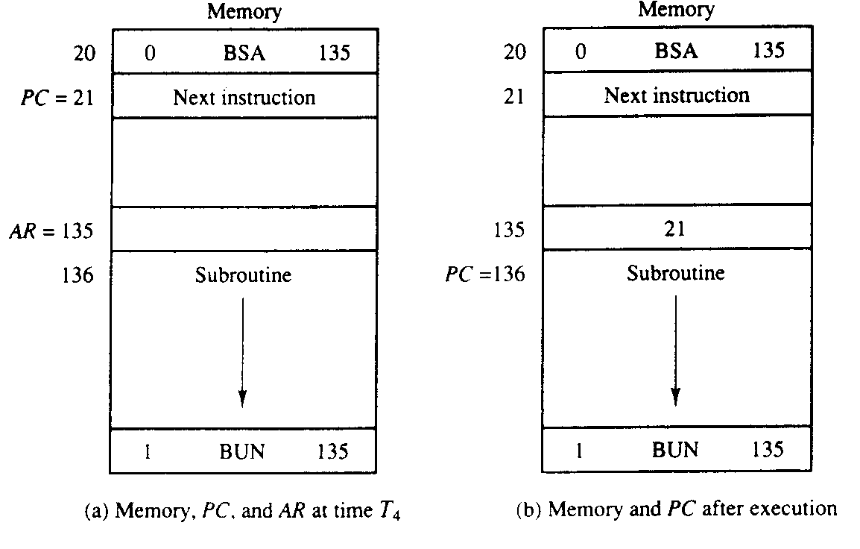

Slide 45
ISZ: Increment and Skip if Zero
ISZ instruction increments the word referred by the effective address, and if the incremented value of the word is equal to 0, PC is incremented by 1. A negative number in 2's complement form is generally stored in the memory word. Since this negative number is continually incremented by one, at last it becomes zero. At that time to skip the next instruction PC is incremented by one in order.

Slide 46
Now we have to read the word into DR, increment DR, and store the word back into memory, because it is not possible to increment a word inside the memory,. This can be done with the following sequence of micro operations:
D₆T₄: DR ←MR[AR]
D₆T₅: DR ← DR + 1
D₆T₆: M[AR] ←DR, if (DR = 0) then (PC ← PC +1), SC ← 0

Slide 47
Control Flowchart
It should be noted that we need only seven timing signals to execute the longest instruction (ISZ). The computer can be designed with a 3-bit sequence counter. The reason for using a 4-bit counter for SC is to provide additional timing signals for other instructions that are presented in the problems section.

Slide 48
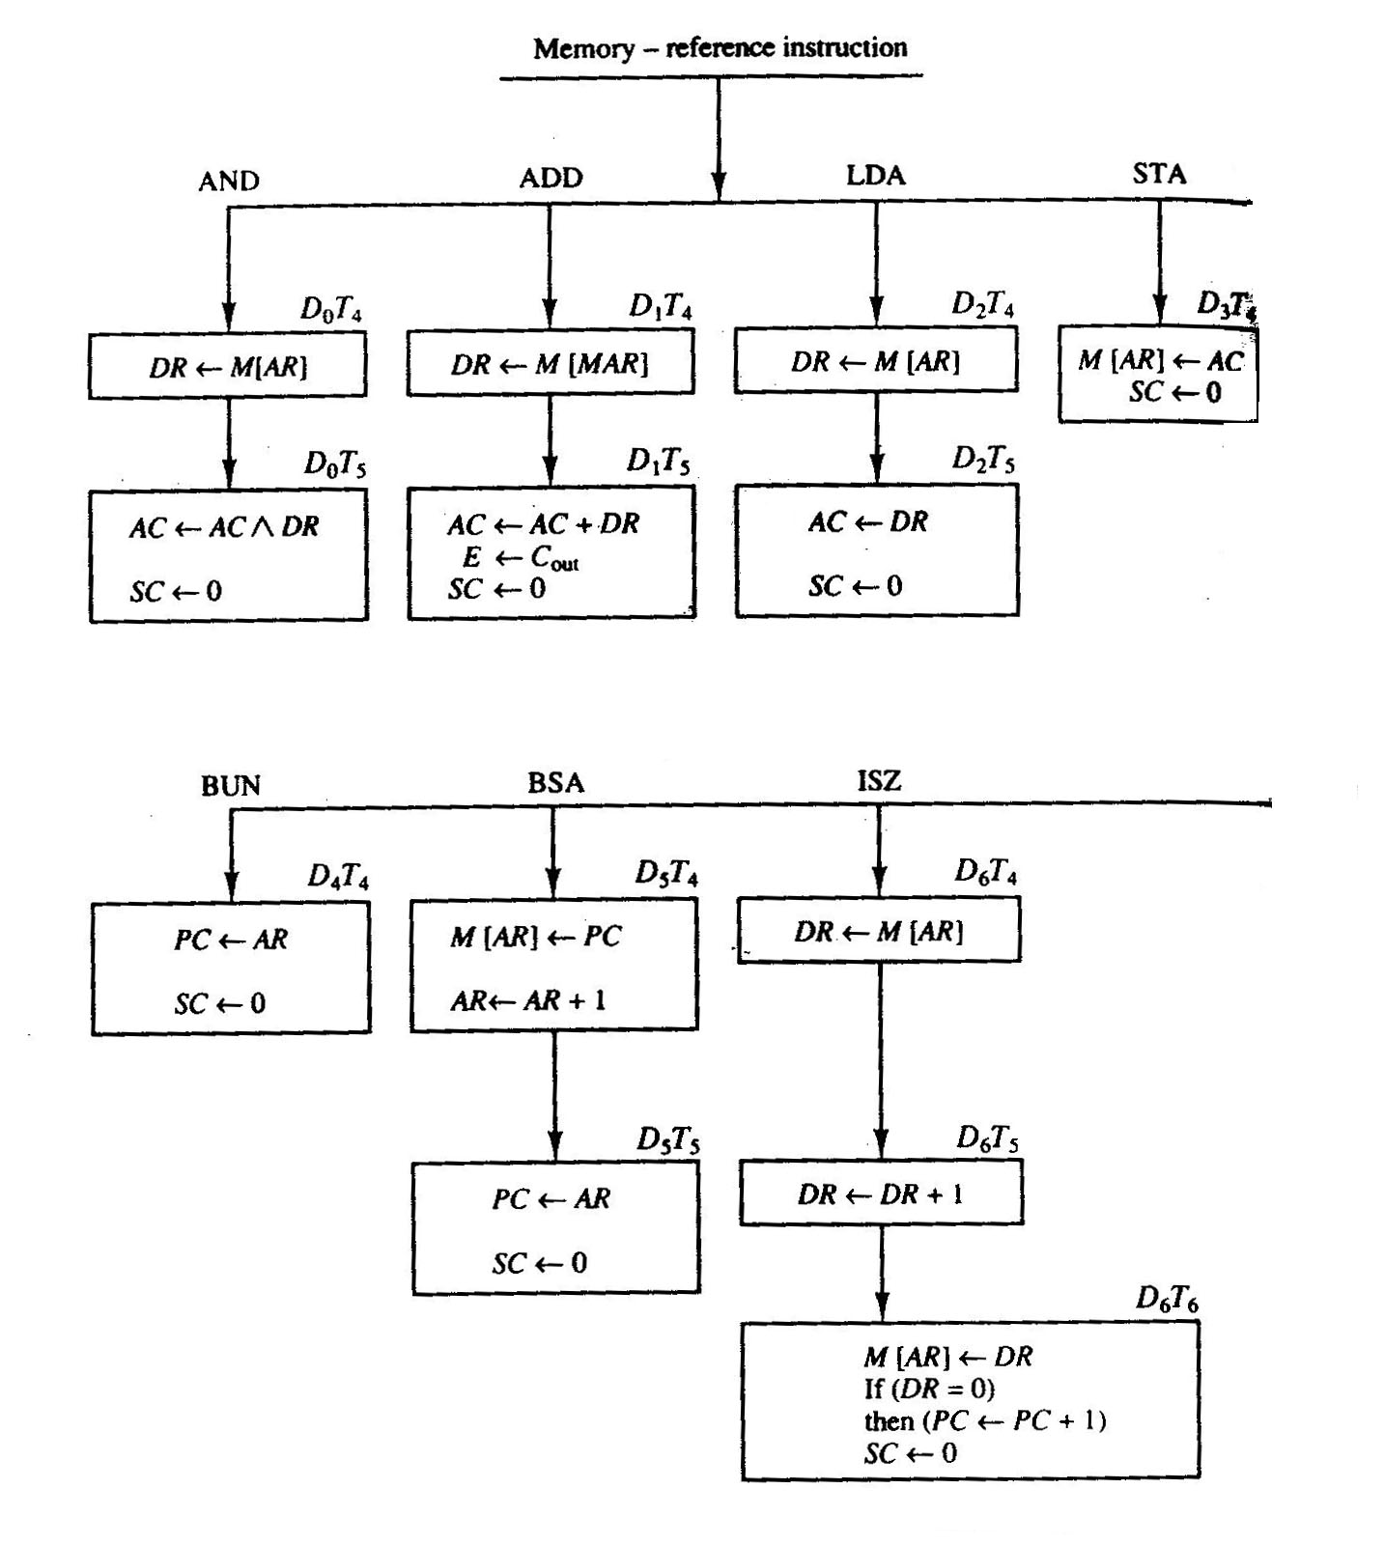

Slide 49
Student Activity
1. Give different phases of instruction cycle.
2. Distinguish between Hardwired control and micro programmed control.

Slide 50
Input, Output and Interrupt
An alphanumeric code of eight bits is required for each quantity of information. The serial information from the keyboard is shifted into the input register INPR. The output register OUTR stores the serial information for the printer. These two registers communicate with a communication interface serially and with the accumulator in parallel. The I/O configuration is shown in following figure.

Slide 51
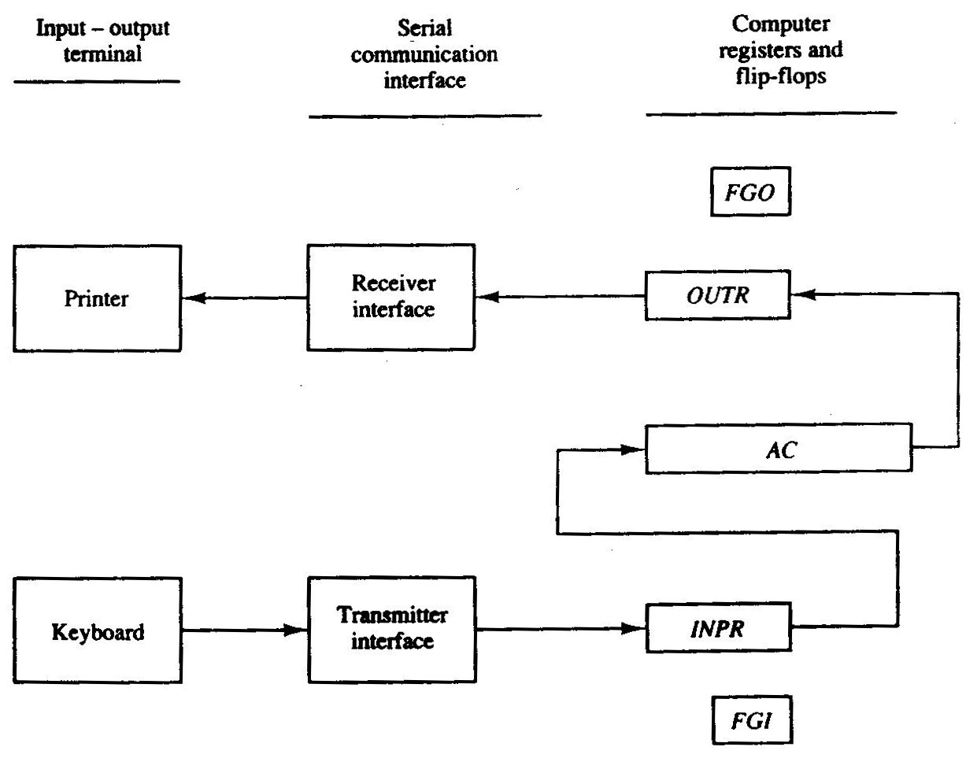

Slide 52
Program Interrupt
The interrupt enables flip-flop IEN can be set (to 1) and cleared (to 0) with two instructions. When IEN is cleared the flags cannot interrupt the computer. When IEN is set, it means that the computer can be interrupted. With the help of these two instructions a programmer can now decide whether or not to use the interrupt facility. An interrupt flip-flop R is included in the computer. When R = 0, the computer goes through an instruction cycle. While the execution phase of the instruction cycle IEN is checked by the control. If it is 0, it means we do not want to use the interrupt, therefore control continues with the next instruction cycle. If IEN is 1, control checks the flag bits. If both flags are 0, then it shows that neither the input nor the output registers are ready for information transfer. In this case, control continues with the next instruction cycle. If either flag is set to 1 while IEN = 1, flip-flop R is set to 1.

Slide 54
Complete Computer Description
Complete Computer Description is given in the flowchart. It consists of instruction cycle, including the interrupt cycle for the basic computer as shown in Figure 4.7. The interrupt flip-flop R may be set at any time during the execution phase. Control returns to timing signal T₀ after SC is cleared to 0. If R = 1, the computer goes through an interrupt cycle. If R = 0, the computer goes through an instruction cycle. If the instruction is one of the memory-reference instructions, the computer first checks if there is an indirect address and then continues to execute the decoded instruction according to the flowchart

Slide 55
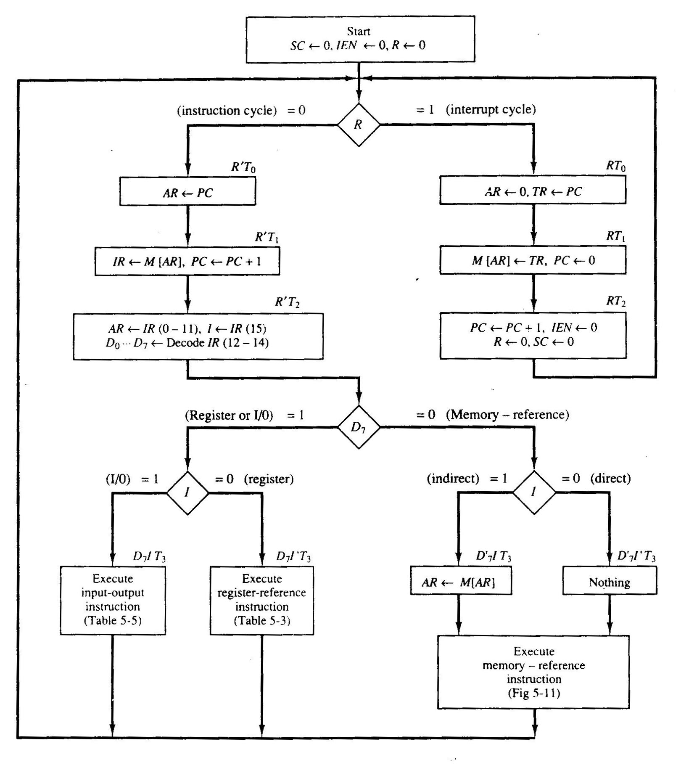

Slide 56
The control functions and micro operations for the whole computer are given in Table 4.4. The register transfer statements in this table shows in a concise form the internal organization of the basic computer. Register transfer statements also provide the information required for the design of the logic circuits of the computer. Boolean functions for the gates is determined by the control functions and conditional control statements listed in the table. The micro operations given in the table give the type of control inputs required for the registers and memory. A register transfer language is useful for specifying the logic circuits needed for its design. It is useful for describing the internal organization of a digital system.

Slide 57
